Slide 1
SQL Lesson 10a
Aggregating Data Using Group Functions
V1.0 2020

Slide 2
Lesson Objectives
After completing this lesson you will be able to
Differentiate between single-row functions and group functions
Aggregate data with Group Functions
Break out aggregated data into separate groups
Include or exclude groups by using the having clause
Nest group functions inside one another

Slide 3
Group Functions
1. Subject (Arial 20)
Single-Row vs Group Functions
Types of Group Functions
Creating Groups
Filtering Groups
Nesting Group Functions

Slide 4
Single-row vs group functions
Single-row functions return one output row for every row selected
Input Rows Output Rows
Single-row
Function
Group functions return one output row for every GROUP of input rows
Input Rows Output Row
Group
Function

Slide 5
Group Functions
Single-Row vs Group Functions
Types of Group Functions
Creating Groups
Filtering Groups
Nesting Group Functions

Slide 6
Types of group functions
Function | Returns
MIN | The minimum value
MAX | The maximum value
SUM | The total of numeric values
AVG | Two average of numeric values
COUNT | The number of occurrences
STDDEV | Standard deviation; the square root of the VARIANCE
VARIANCE | The average of the squared differences from the mean; STDDEV squared
This course does not discuss STDDEV and VARIANCE

Slide 7


Types of group functions
Using the COUNT Function
SELECT COUNT(manager_id)
FROM departments;
COUNT(*) returns the number of rows
SELECT COUNT(*)
FROM departments;

Slide 8

Types of group functions
COUNT (DISTINCT col) returns the number of distinct values
SELECT COUNT(DISTINCT manager_id)
FROM employees;

Slide 9


Types of group functions
MIN and MAX can be used with numeric, character, date, and timestamp datatypes
SELECT MIN(hire_date), MAX(hire_date)
FROM employees;
SELECT MIN(city), MAX(city)
FROM locations;

Slide 10

Types of group functions
Using the MIN and MAX functions
SELECT MIN(salary), MAX(salary)
FROM employees;

Slide 11

Types of group functions
SUM and AVG can only be used with number data
SELECT SUM(salary), AVG(salary)
FROM employees;

Slide 12


Types of group functions
Group functions ignore nulls in the column
SELECT AVG(commission_pct)
FROM employees;
The NVL function forces group functions to include nulls
SELECT AVG(NVL(commission_pct, 0))
FROM employees;

Slide 13
Group Functions
Single-Row vs Group Functions
Types of Group Functions
Creating Groups
Filtering Groups
Nesting Group Functions

Slide 14
Creating groups of data
Rows in a table can be divided into smaller groups using the GROUP BY clause
SELECT column1, group_function(column2)
FROM table
[WHERE condition]
GROUP BY column1
[ORDER BY column(s)];

Slide 15
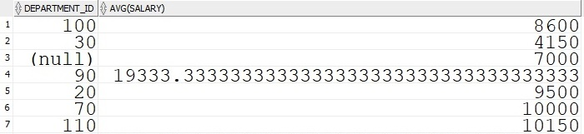
Creating groups of data
All the columns in the SELECT list other than the aggregated column must be included in the GROUP BY clause
SELECT department_id, AVG(salary)
FROM employees
GROUP BY department_id;

Slide 16
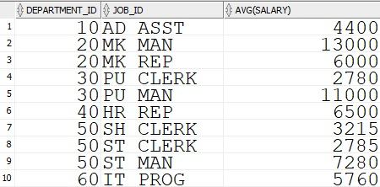
Creating groups of data
Data can be aggregated by groups within groups. The GROUP BY clause can be applied across multiple columns
SELECT department_id, job_id, AVG(salary)
FROM employees
GROUP BY department_id, job_id
ORDER BY department_id;

Slide 17
Group Functions
Single-Row vs Group Functions
Types of Group Functions
Creating Groups
Filtering Groups
Nesting Group Functions

Slide 18
Filtering groups of data
Filter groups with the HAVING clause
Oracle restricts groups as follows
- Rows are grouped
- The group function is applied
- Groups matching the HAVING clause are displayed
SELECT column, group_function
FROM tables
WHERE condition
GROUP BY column
HAVING condition
ORDER BY column(s);

Slide 19
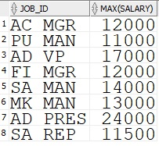
Filtering groups of data
Using the HAVING clause
SELECT job_id, MAX(salary)
FROM employees
GROUP BY job_id
HAVING MAX(salary) > 10000;

Slide 20
Group Functions
Single-Row vs Group Functions
Types of Group Functions
Creating Groups
Filtering Groups
Nesting Group Functions

Slide 21

Filtering groups of data
Display the largest average salary by job_id
SELECT MAX(AVG(salary))
FROM employees
GROUP BY job_id;

Slide 22
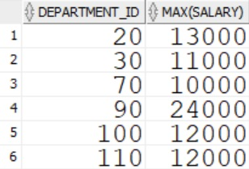
Summary
You have now learned all six basic clauses used in SELECT statements
SELECT department_id, MAX(salary)
FROM employees
WHERE commission_pct IS NULL
GROUP BY department_id
HAVING MAX(salary) >= 10000
ORDER BY 1;

Slide 23
Quiz
True or False
Group functions return as many output rows as input rows
When selecting columns next to group functions, the GROUP BY clause is optional
The HAVING clause restricts which groups will be displayed
Group functions can be nested inside other group functions
The HAVING clause serves the same purpose as the WHERE clause
Group functions include nulls in their calculations

Slide 24
Review
In this lesson you learned how to
Differentiate between single-row functions and group functions
Aggregate data with Group Functions
Break out aggregated data into separate groups
Include or exclude groups by using the having clause
Nest group functions inside one another

Slide 25
Questions?

